Slide 1
Human Form & Function
Body systems
The skeleton

Slide 2
Skeletal system
The skeletal system consists of the bones, joints, ligaments and cartilages in the body.
The functions of the skeletal system are to:
  protect and support the internal organs,
  provide anchor points for the muscles to allow movement,
  produce blood cells.

Slide 3
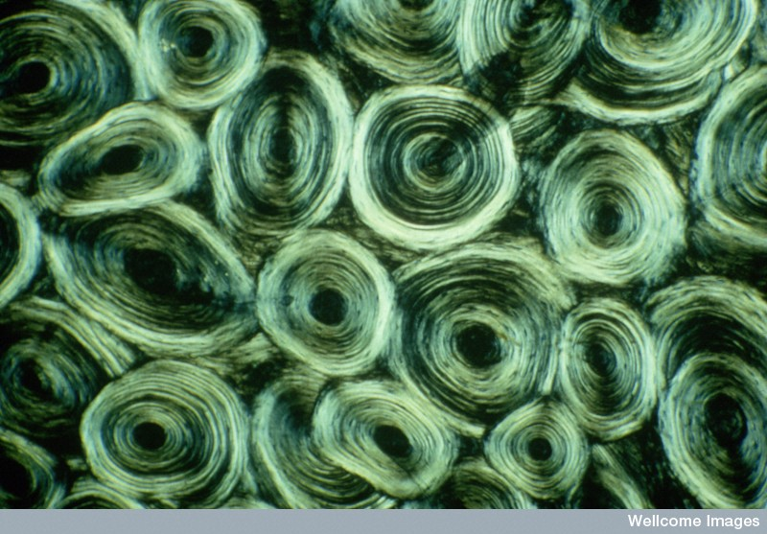
The microscopic structure of bone
Prof Alan Boyde, Wellcome Images

Slide 4
Bone
Bone is classified as a connective tissue.
It has a brittle, calcified matrix with many collagen fibres, giving bones a degree of pliability.
Several types of cells occur in bone. These include osteoblasts, which are young, bone-forming cells, and osteocytes, which are mature cells contained in cavities (lacunae).
Bone has a rich blood supply.

Slide 5
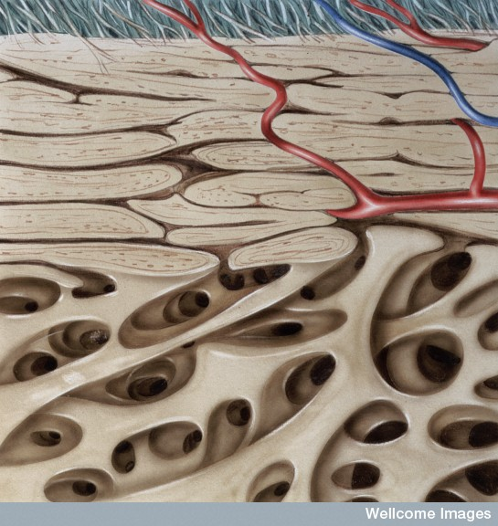
There are two types of bone – compact bone, which is very hard and dense, and spongy bone, which is porous, consisting of a network of small bony plates.
Compact bone
Spongy bone
Medical Art Services, Munich, Wellcome Images

Slide 6
Compact bone
Compact bone consists of Haversian systems.
A Haversian system comprises circular layers of bone (lamellae) surrounding a central Haversian canal, which carries blood and lymph vessels.

Slide 7
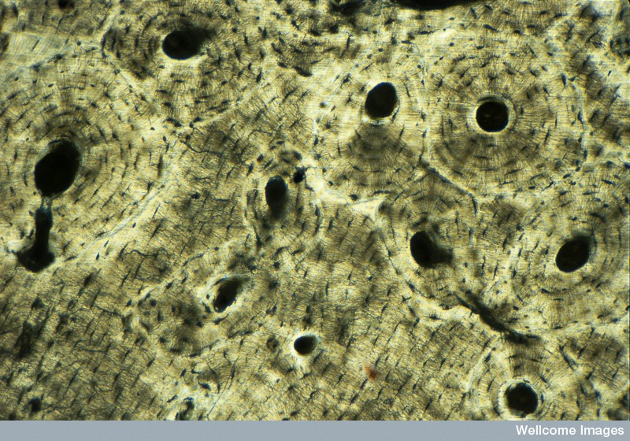
Haversian systems
Haversian system
Haversian canal
Concentric lamellae
M I Walker, Wellcome Images

Slide 8
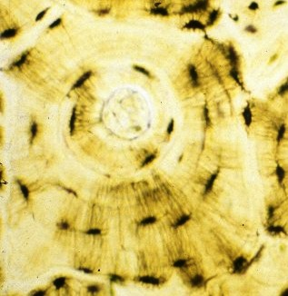
Haversian systems
Concentric lamellae
Central canal
Lacunae housing mature osteocytes
Wellcome Photo Library

Slide 9
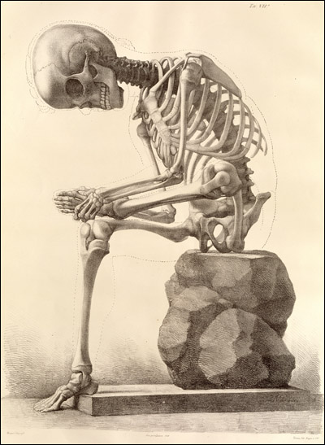
The skeleton

Slide 10
Bone classification
Bones can be classified according to their shape and their structure.
Classification by shape
Long bone – e.g. Thigh bone (femur)
Short bone – e.g. wrist bones (carpals)
Flat bone – e.g. shoulder blade (scapula)
Irregular bone – e.g. vertebrae
Sesamoid bones develop in tendons – e.g. kneecap (patella)

Slide 11
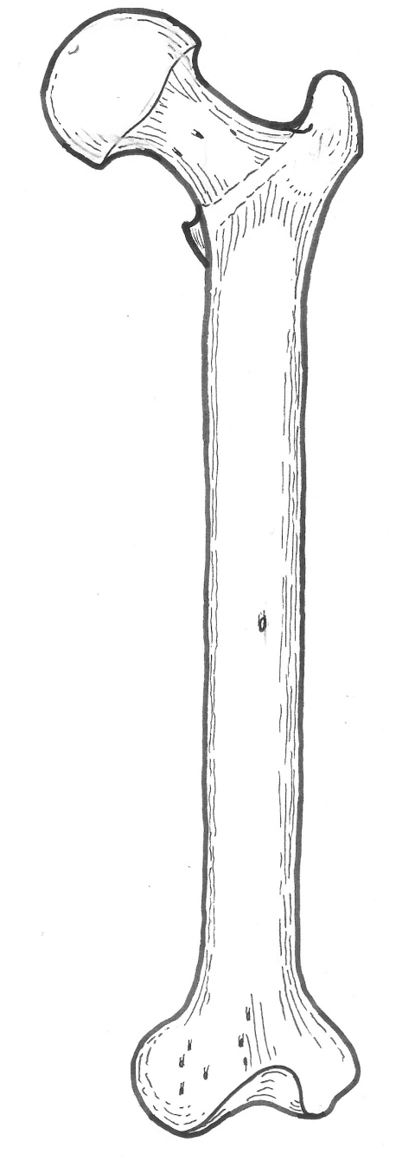
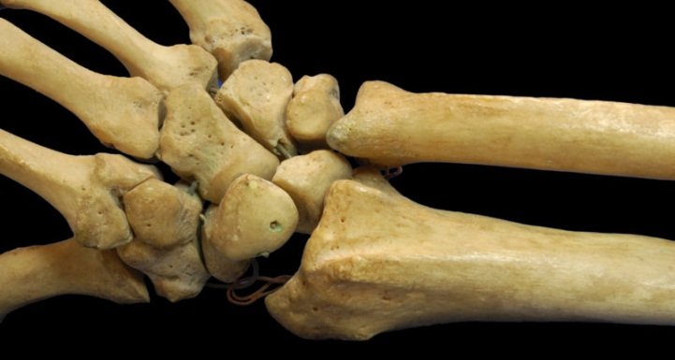
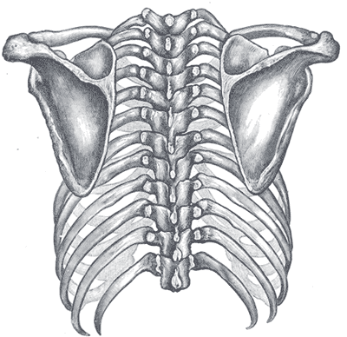
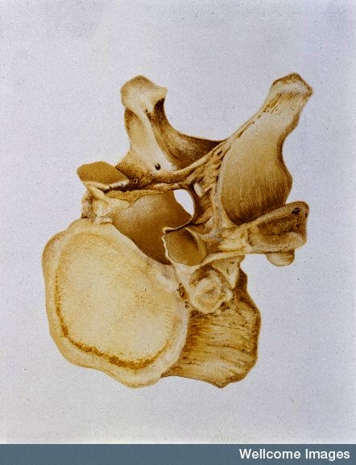
Short bones
Flat bones
Long bone
Irregular bone
Medical Art Services, Munich, Wellcome Images

Slide 12
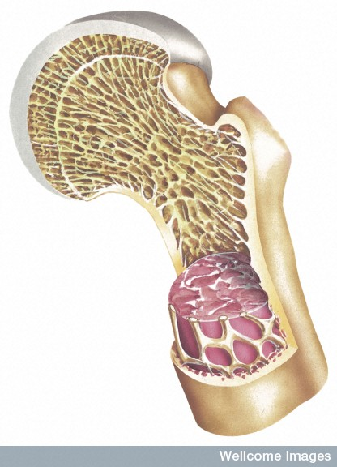
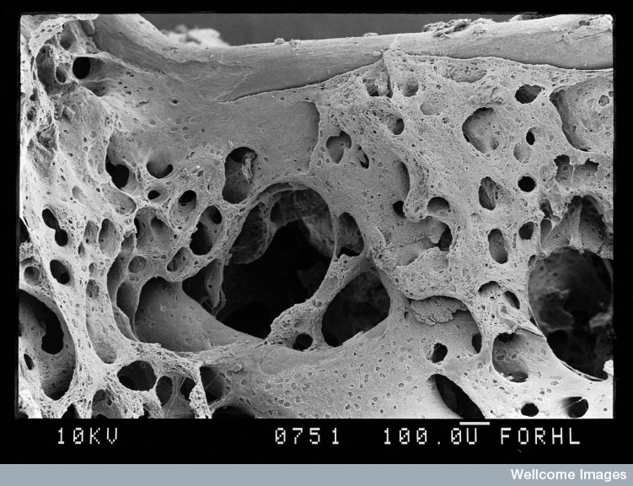

Bones classified by structure
Spongy or cancellous bone
Epiphysis
D Gregory & D Marsgall, Wellcome Images
Diaphysis
Compact
or dense bone
The Miles Kelly Art library, Wellcome Images
M I Walker, Wellcome Images

Slide 13
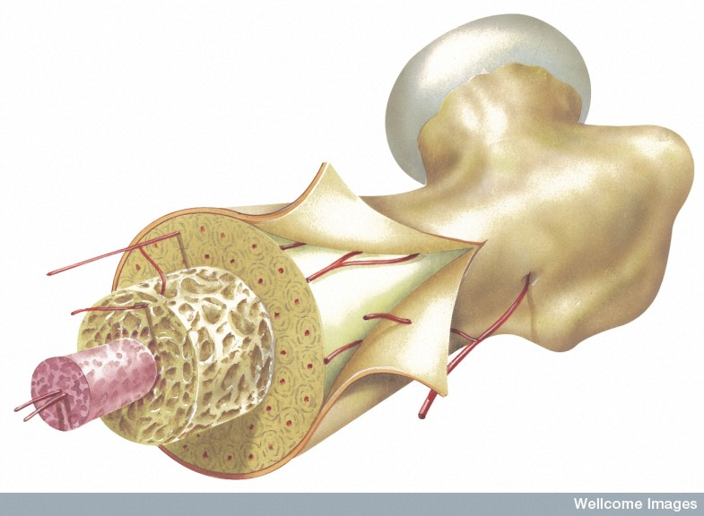
Structure of a long bone
Articulating cartilage
Growth cartilage
Spongy or cancellous bone
Epiphysis
Marrow cavity
Periosteum
Diaphysis
Compact
or dense bone
The Miles Kelly Art library, Wellcome Images

Slide 14
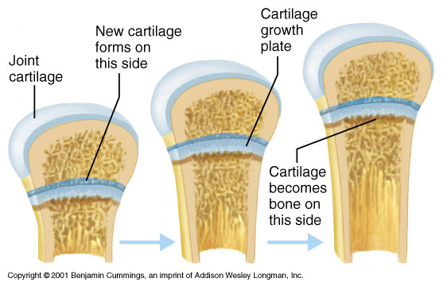
Growth plate

Slide 15
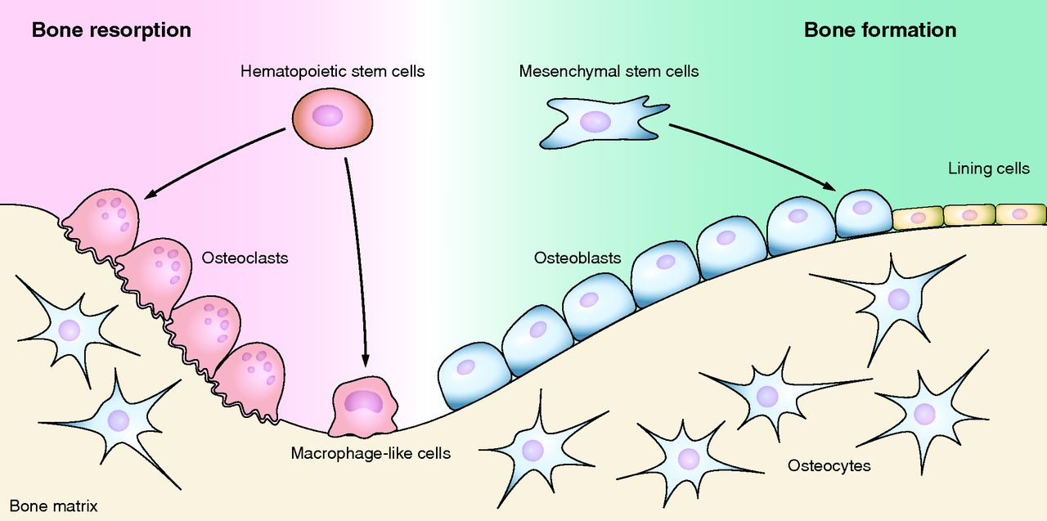

Slide 16
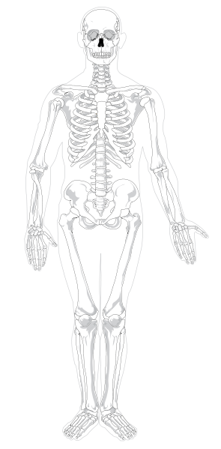
The human skeleton
Skull
Cervical vertebrae
Clavicle
Scapula
Sternum
Ribcage
Lumbar vertebrae
Humerus
Ulna
Pelvis
Radius
Femur
Carpals & metacarpals
Fibula
Phalanges
Tibia
Carpals & metacarpals
Phalanges
Mariana Ruiz Villarreal

Slide 17
Axial & appendicular skeleton
Axial skeleton
  Skull
  Vertebral column (backbone)
  Ribcage
Appendicular skeleton
  Pectoral girdle
  Upper limbs
  Pelvic girdle
  Lower limbs

Slide 18
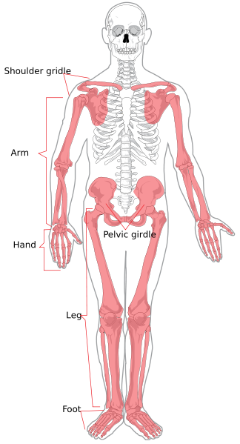
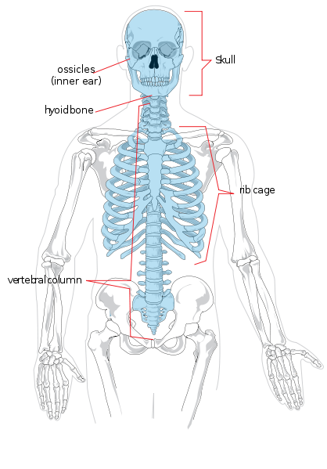
Axial & appendicular skeleton
Axial skeleton
Appendicular skeleton
Mariana Ruiz Villarreal

Slide 19
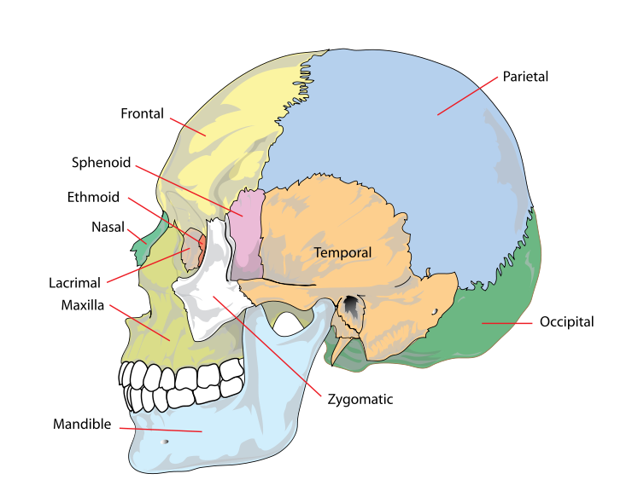
Skull
Mariana Ruiz Villarreal

Slide 20
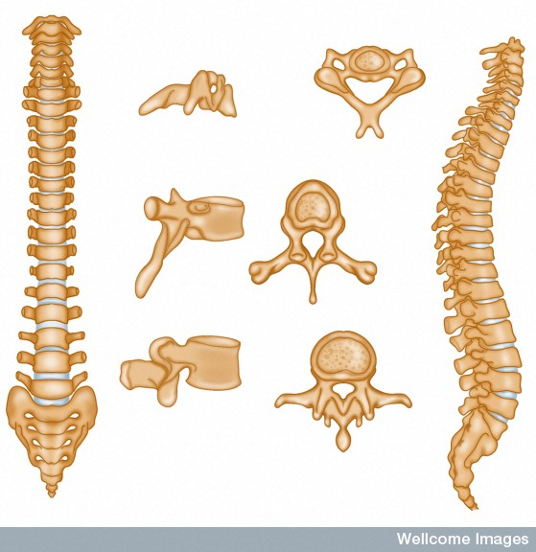
Vertebral column
Cervical vertebrae
7 cervical
vertebrae
Thoracic vertebrae
12 thoracic
vertebrae
Lumbar vertebrae
5 lumbar
vertebrae
5 fused sacral vertebrae
Coccyx
3-5 vertebrae
Wellcome Photo Library

Slide 21
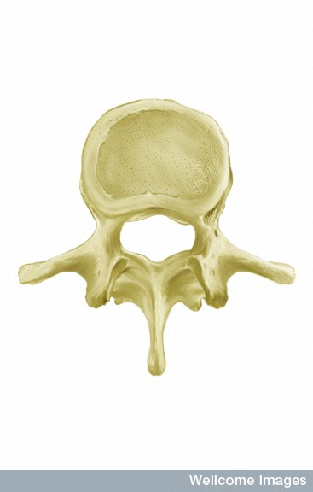
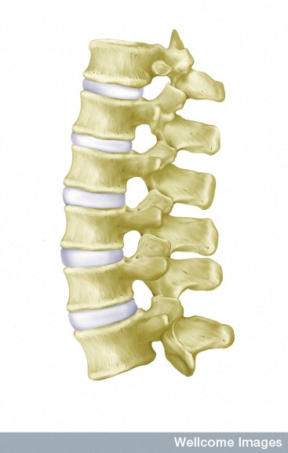
Structure of a vertebra
Intervertebral disc
Body
Vertebral foramen
Transverse process
Articulating surface
Spinous process
Medical Art Services, Munich, Wellcome Images

Slide 22
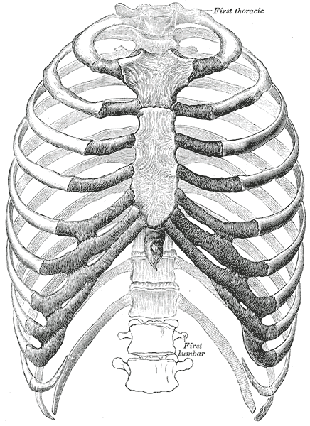
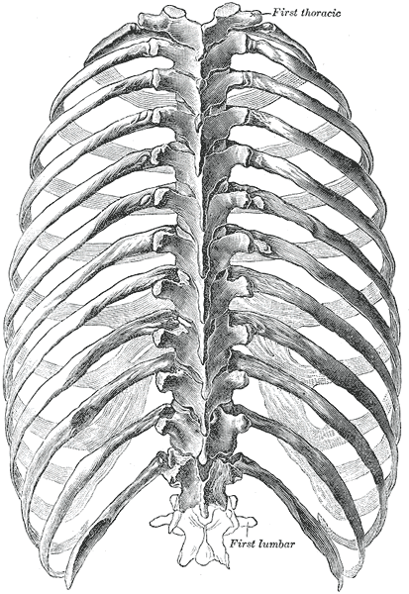
Ribcage
Sternum
Costal
cartilage
Anterior
Posterior
Gray’s Anatomy

Slide 23
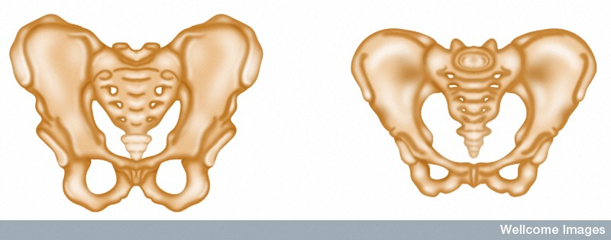
Pelvic girdle
Male
Female
Ilium
Pubis
Ischium
Ischium
< 90°
>100°
Wellcome Photo Library

Slide 24
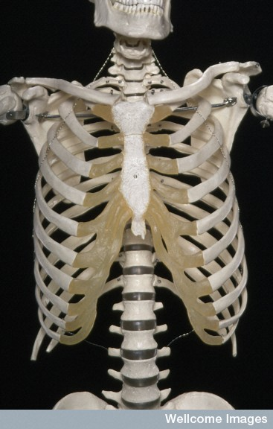
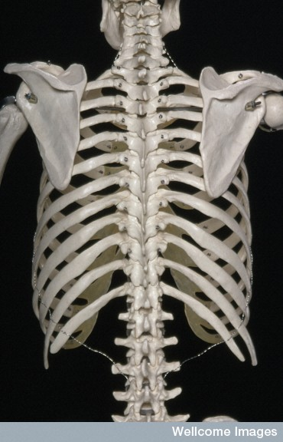
Pectoral girdle
Clavicle
Scapula
Wellcome Photo Library

Slide 25
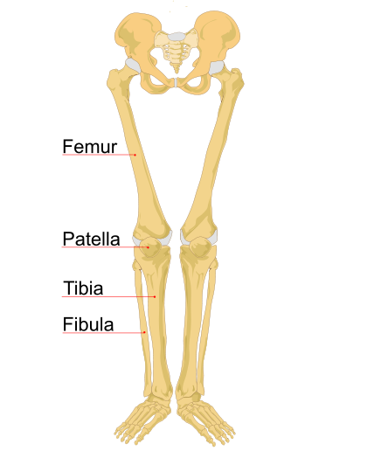
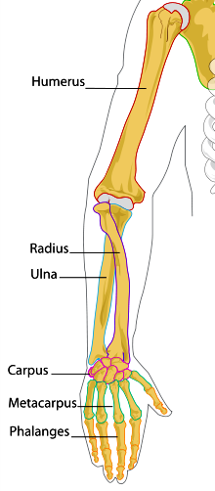
The upper and lower limbs
Tarsus
Metatarsus
Phalanges
Mariana Ruiz Villarreal

Slide 26
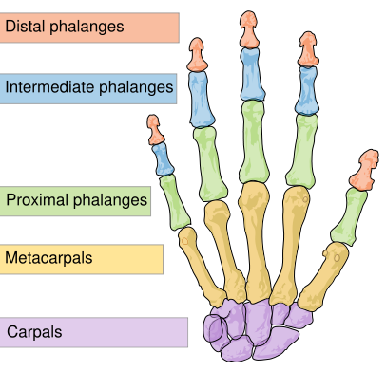
The hand
Mariana Ruiz Villarreal

Slide 27
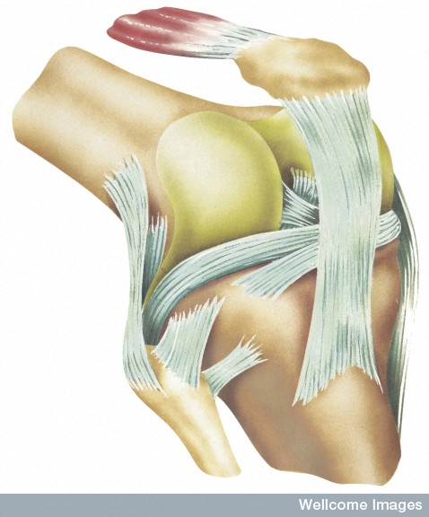
Joints
Medical Art Services, Munich, Wellcome Images

Slide 28
Joint classification
Joints can be classified by their structure and the amount of movement they allow.
Structure | Joint cavity | Movement
Fibrous | None | None
Cartilaginous | None | None or slight
Synovial | Present | Freely movable

Slide 29
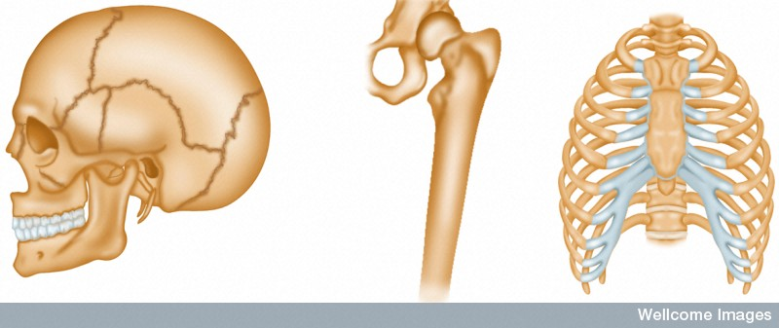
Types of joints
Immovable fibrous joint
Movable
synovial joint
Slightly movable cartilaginous joint
Wellcome Photo Library

Slide 30
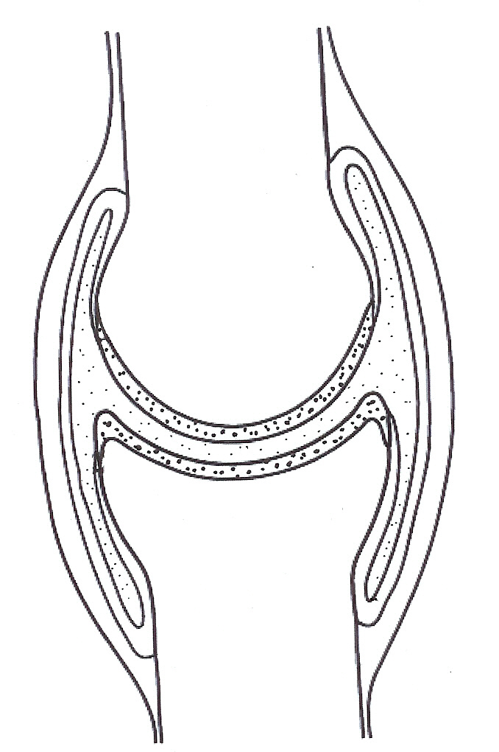
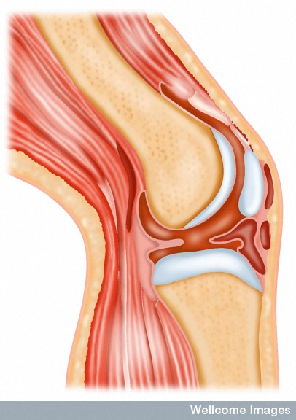
The structure of a synovial joint
Fibrous capsule
Synovial membrane
Bursa
Joint cavity
Articulating cartilage
Wellcome Photo Library

Slide 31
Can you name these ligaments of the knee joint?

Slide 32
Synovial joints
Synovial joints have a joint cavity and are classified according to the type of movement they allow.

Slide 33
Hinge joint
Flexion
Extension
Abduction
Ball & socket joint
Rotation
Adduction
Adduction
Pivot joint
Rotation

Slide 34
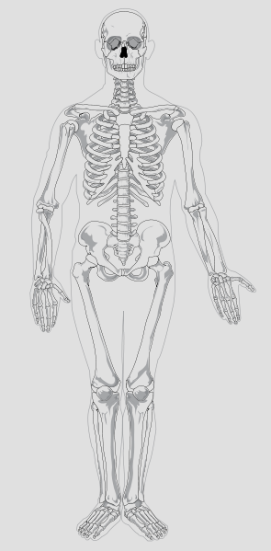
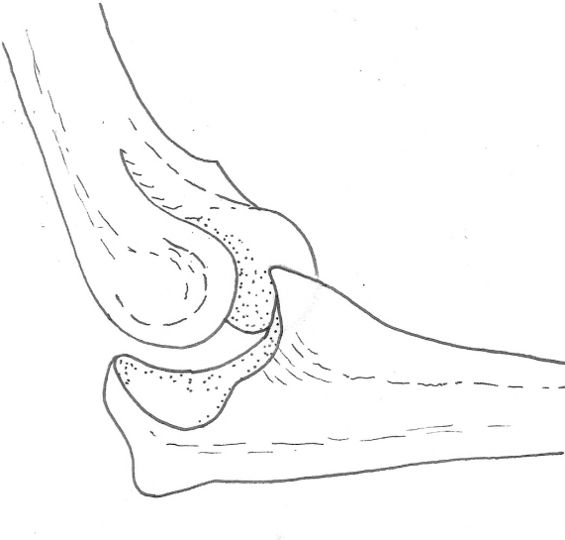
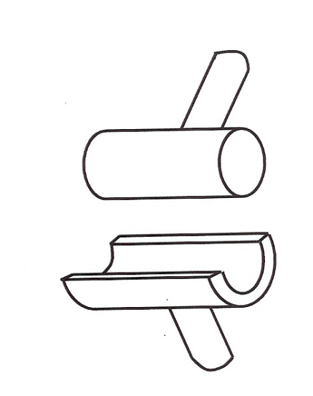
Hinge joint
Mariana Ruiz Villarreal

Slide 35
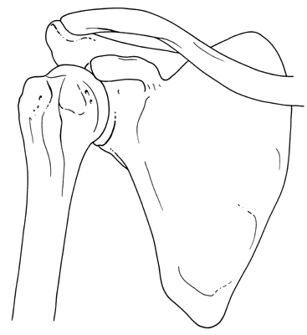
Ball and socket joint
Mariana Ruiz Villarreal

Slide 36
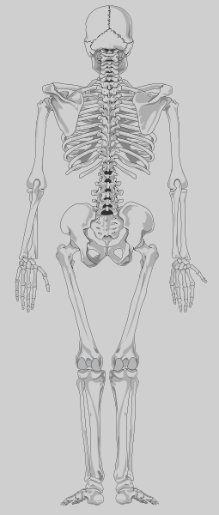
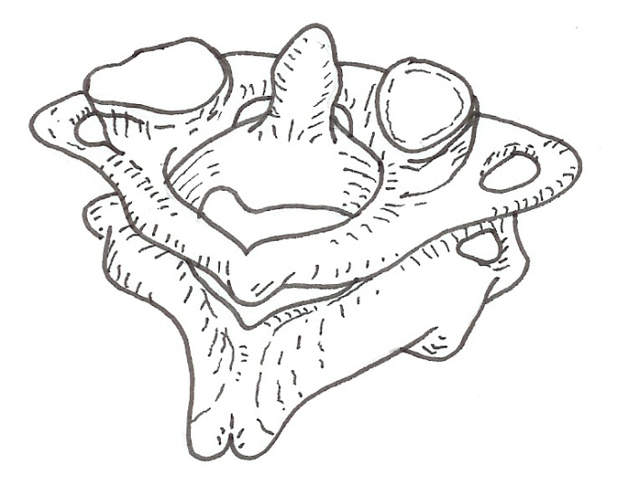
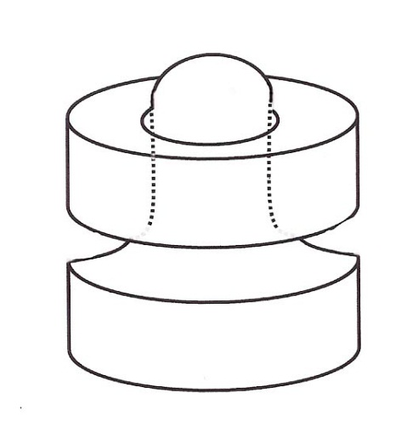
Pivot joint
Mariana Ruiz Villarreal

Slide 37
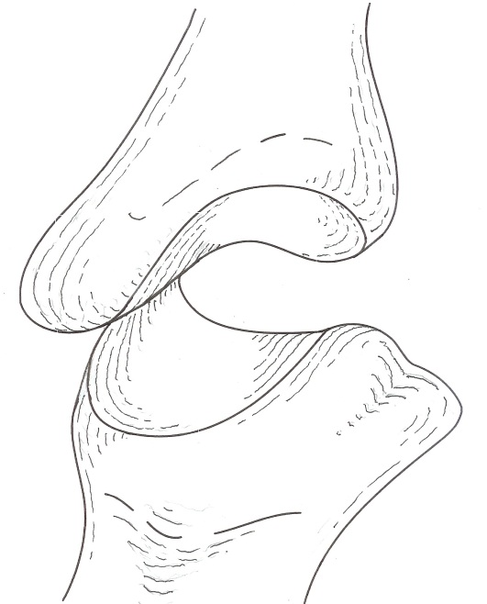
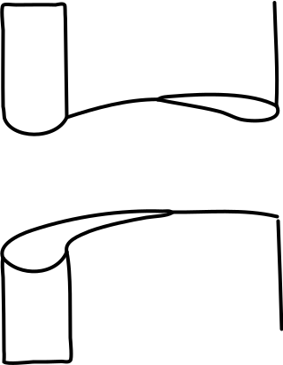
Saddle joint
Mariana Ruiz Villarreal

